Slide 1
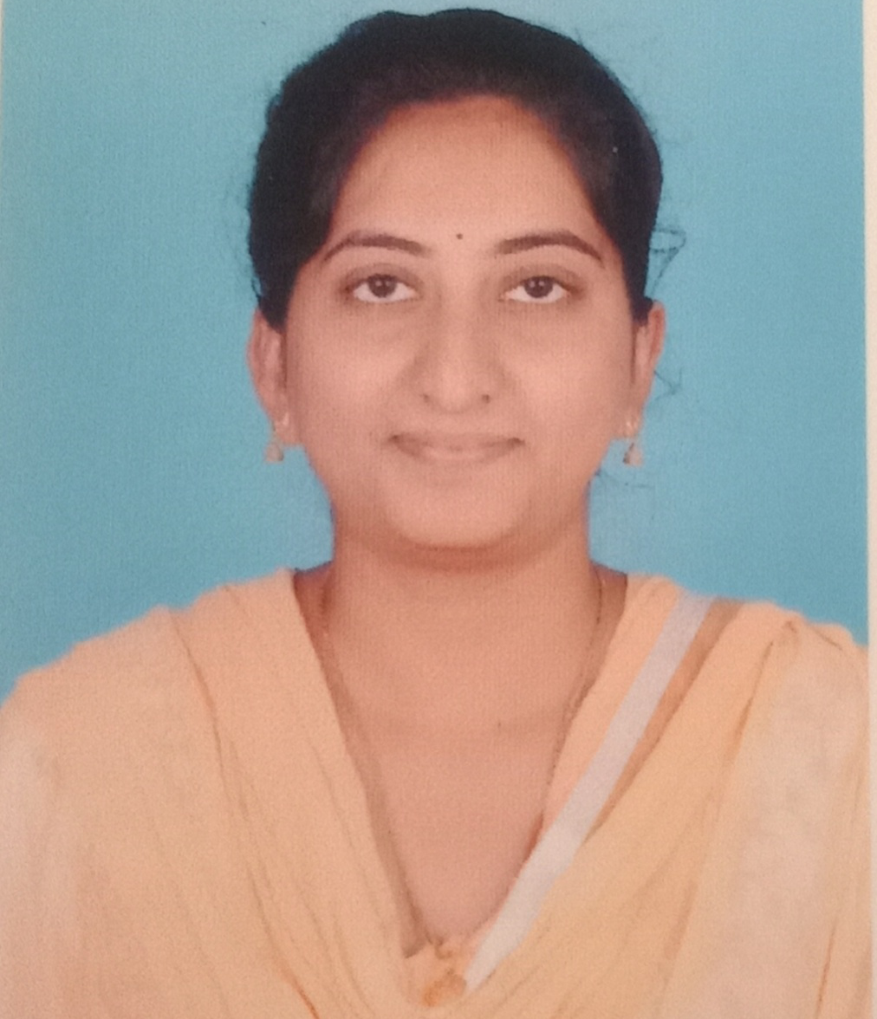
Divyarupa Chevuru
Analyst/Software Engineer
Bachelor of Technology
Electronics and Communication Of Engineering 2015-2019
Skills C#
Asp.net
Core Mvc
Core Java
Database
SQL database – MySQL
Web Technologies
HTML
Add-ons
GitHub
Postman
Fiddler
Additional Details
Leadership
Excellent Communication Skills
Team management
Quick Learner
Mumbai
divyarupa.chevuru@capgemini.com
+919346581522
A4
A self-driven learner eager to work in a team of dedicated people and serve a key role in the enhancement and development of the project.
A team player with good communication skills always ready to work for the enrichment of knowledge.
Proficient in C# and OOPs concepts.
Hands on experience in creating Web Application with Asp.net and Mvc Core.
Hands on experience in developing web pages using HTML5,Asp.net, Object Oriented Programming.
Experience in creating documentation with swagger.
Online shopping
Completed end to end case study of Online shopping along with Swagger, Fiddler testing using Core Mvc, Web Api and MsSql
Trained on Dot Net, SQL Server, Ado.net, Core Mvc, Core Web API, Entity Framework.

